Slide 1
এসো সহজে ইংরেজি শিখি
WELCOME EVERYBODY

Slide 2
Jahanara khatun
Hazi Afser Uddin Sec.Girls High School.
Bheramara , kushtia .

Slide 3
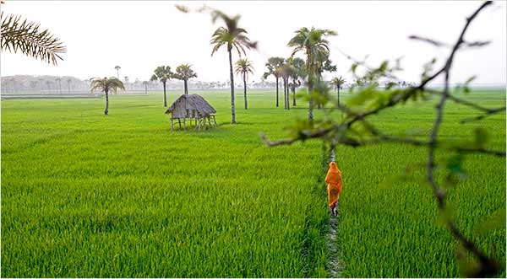



Assalamu Alaikum Warahmatullah
Notes:
Welcome slide.

Slide 4

Lesson Plan
Class-vi
Subject:English 1st paper
Lesson 1 Going to a new school..
Todays Subject

Slide 5
Our Todays Lesson
Going To A New School
Going To A Nl

Slide 6
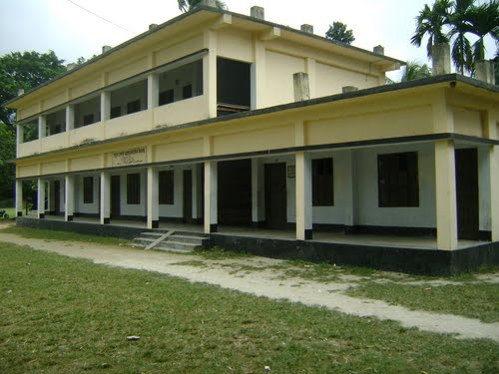
My School .

Slide 7
Warmly--
Friendly--
Greeting-- Embrassed-

Slide 8
Student can write down similar information by folloing the section A
1. My name is--------.
2. I am ---- years old.
3. I have --- eyes --- hair, and I am ---, ---- tall.
I am good at ------ and ----------.
-- --
-- ---
--- --.

Slide 9

Silent Reading
Student Able To Read The Text Book

Slide 10
Now student can match Column A and Column B that have similar meaning .

Slide 11
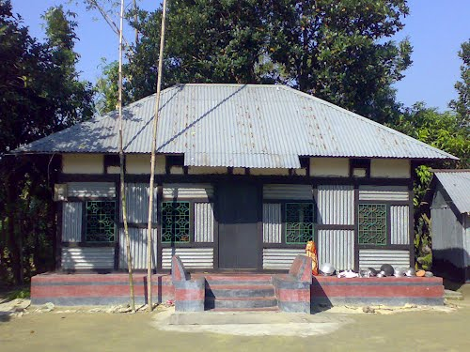
HOME WORK
Write down a paragraph about the first day of your school.

Slide 12
THANK YOU

Slide 13

May Allah bless you.hhhh
Notes:
Ending slide.

